Slide 1

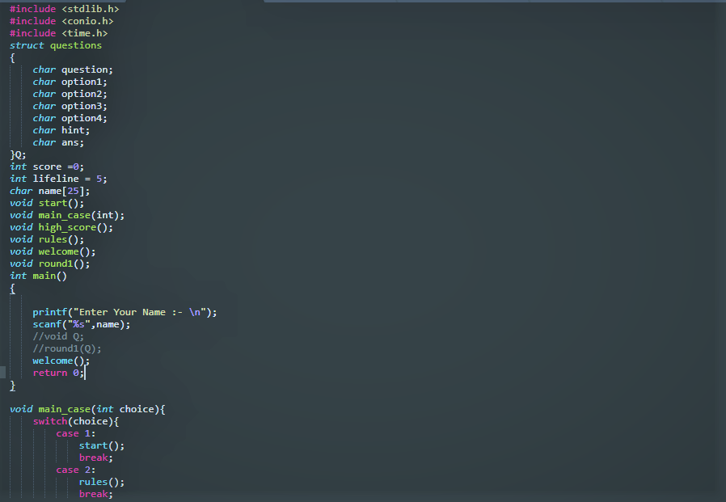
R.R.S.D.C.E, Begusarai
Project Report on Gaming Console
Submitted to
Department of Computer Science & Engineering

Slide 2
SUBMITTED BY
NAME | REG NO
Hrithik Prasad | 18105125044
Kumar Rahul | 18105125043
Pratik Raj | 18105125041
Ankit Kumar | 18105125042
Shivanshi Shailja | 18105125039
Nistha Mishra | 18105125014
Stuti Kumari | 18105125007
Jimmy Kumari | 18105125021
Supervised By
Prof. Rajiv Ranjan

Slide 3
GAMING CONSOLE
“Game Console “this project is all about creating game and adding them in a one single running platform. What have we done is created 3 games and compressed it into one console this console consist of games like.
Snake Game
Tic-Tak-Toe
Quiz
This game involves the snake to eat food which are generated randomly in the screen, with the objective being, to avoid running into a boarder or snake itself for as long as possible
It is basically a multiplayer game, this involves the player to put their character anywhere in the grid of 3*3. A player will win if their character is plotted 3 times in continuous sequence.
This game involves the player to answer the randomly generated question. With the objective to score as high as you can.

Slide 4
REQUIREMENTS
Software Requirement
Hardware Requirement
Operating System: - Windows 10
Application Software: - Dev C++
Language: - C
Hard Disk: - 32GB
Ram: - 128MB

Slide 5
Flowchart of Driver Function
Start
Screen1();
Screen2();
Switch(x)
Case 1
True
Snake Game
It is the driver structure of the main code.
False
Case 2
True
Tic-Tak-Toe
False
Case 3
True
Quiz Game
False
End
Case 4
True
Screen3();
False
default
True
Caller();

Slide 6
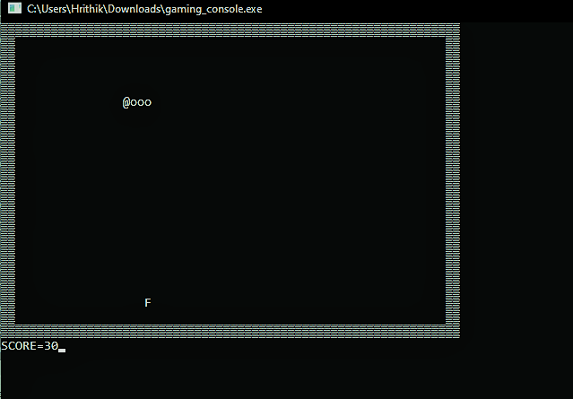
Snake Game
Preface
In case of snake game you control the snake movement by pressing W-up, A-left, S-down, D-right
Foods are provided at several coordinates of the screen for the snake to eat, every time the snake eats the food its length will be increased by one element(on its tail) along score

Slide 7
Flowchart of Snake Game
Start
Welcome
Loading Screen
Set Values
End
Reinitialize Certain Value
Print Score
!Game over
False
True
True
Draws Game Display
False
Statement for tail length
Dir = down
Dir = right
Dir = left
Kbit()
Dir = up
True
True
True
True
True
Switch (dir)
Case ‘S’
Case ‘W’
Case ‘D’
Case ‘A’
Switch(getch())
False
False
False
False
False
False
False
Case ‘left’
Case ‘right’
Case ‘up’
Case ‘down’
default
True
True
True
True
True
True
True
True
True
x--
x++
y--
y++
break
Loop for delaying time
Update score and setting values
Checking condition for game over

Slide 8
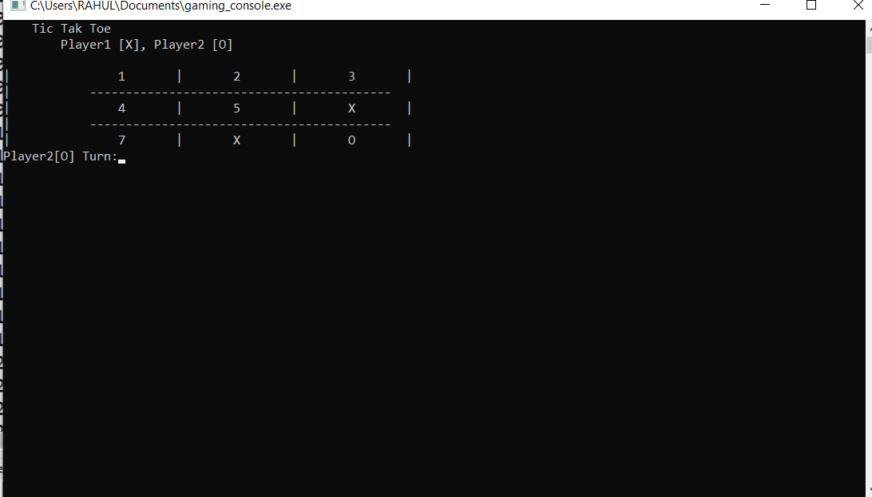
Tik – Tac – Toe
Preface
In case of tic-tac-toe it can be played in multiplayer mode, in this gameplay there’s a grid of 3*3 in which numbers are printed to grid numbers for the purpose of selecting a specific box
A player can input number from 1 to 9 and put their character in that position.
The first player to get 3 of her character in sequential order (up, down, across, diagonal) is winner.
When all 9 squares are full and no player has there 3 character in continuous order, the game ends in tie.

Slide 9
Flowchart of Tic Tak Toe
True
False
Start
Welcome
Loading Screen
(!Complete && time !=9
End
True
Draws game display
False
True
Print2[0] Turn
Active player ==‘x’
Print1[X] Turn
Game Over
True
True
Choice = getch();
Choice == 27
False
Time ==9 && complete ==0
False
Selecting row and column through user input
Time ++
False
Complete = checks();
Set the value and change the active player
Player Won
Complete==1
True

Slide 10
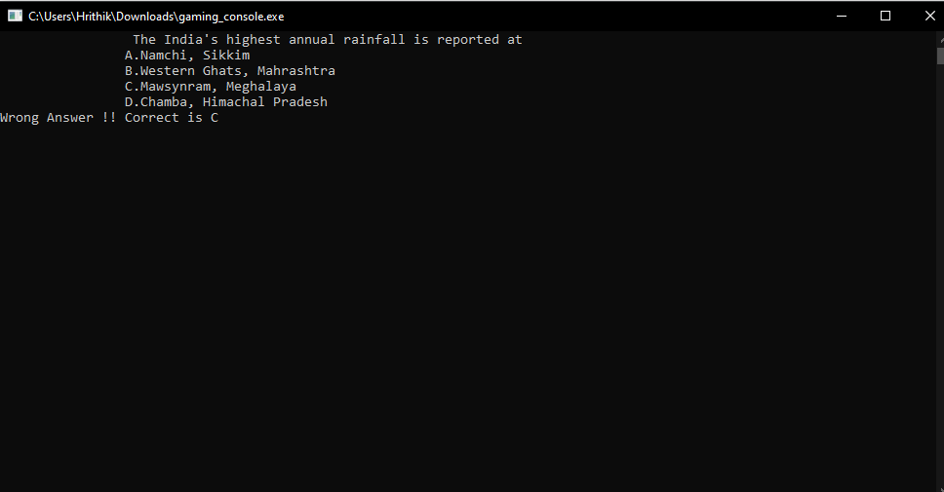
Quiz
Preface
In case of quiz, several questions are displayed on screen player can answer them and find if they are correct or not. They are given 12 Questions, after answering 12 questions player will be taken to end screen along with score.

Slide 11
Flowchart of Quiz Game
False
Start
Welcome
Loading
Count <=11
End
True
Count ++
Questions are chosen in a random order
Print the question
Score ++
Print Correct
getch()==Answer
True
False
True
getch()==27
False
Wrong Answer

Slide 12
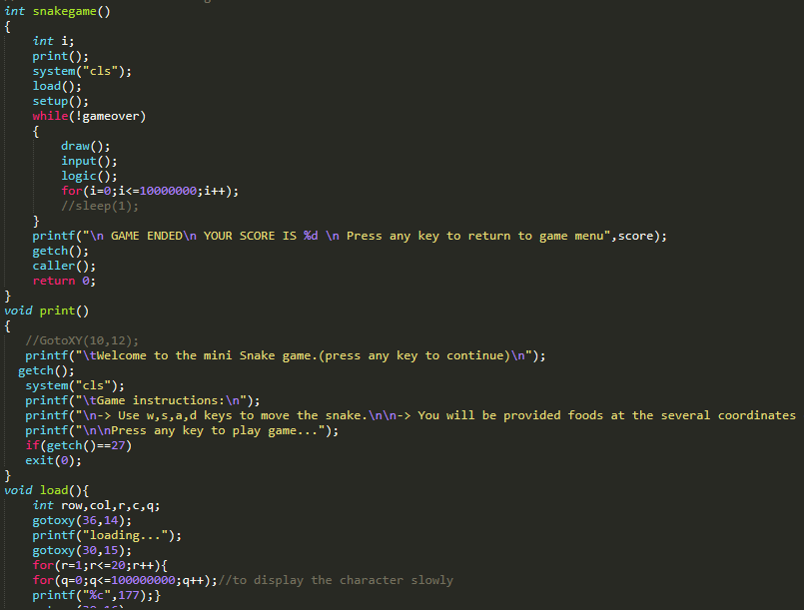
Screenshots
This is the overall snaps of the gameplay at different times.

Slide 13
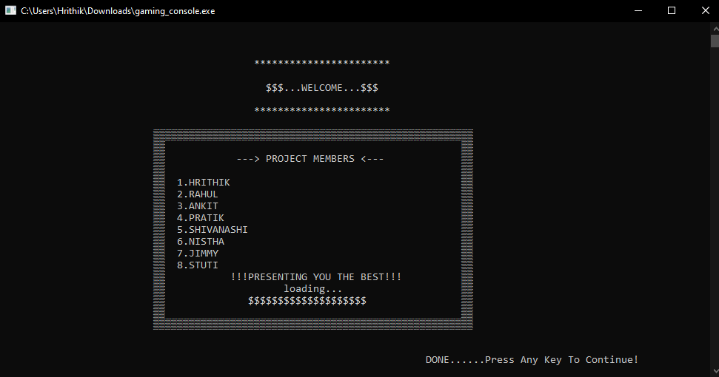
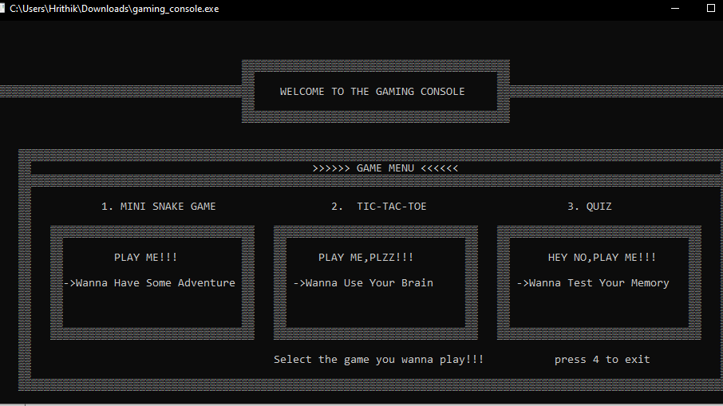
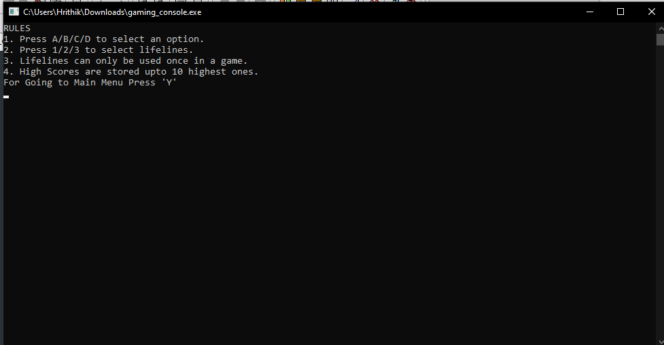
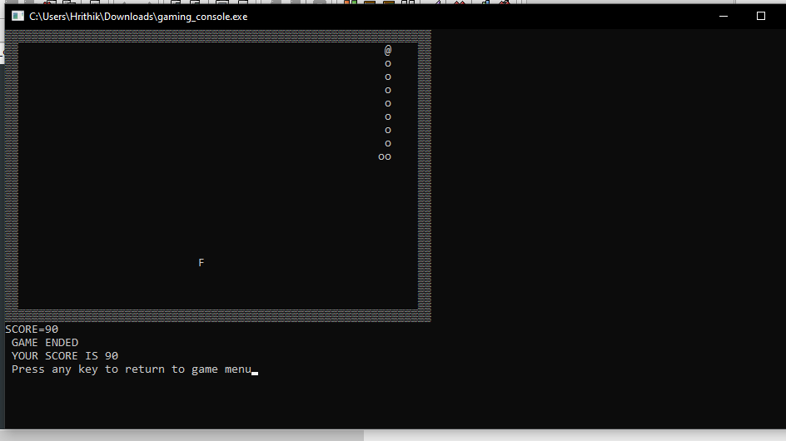
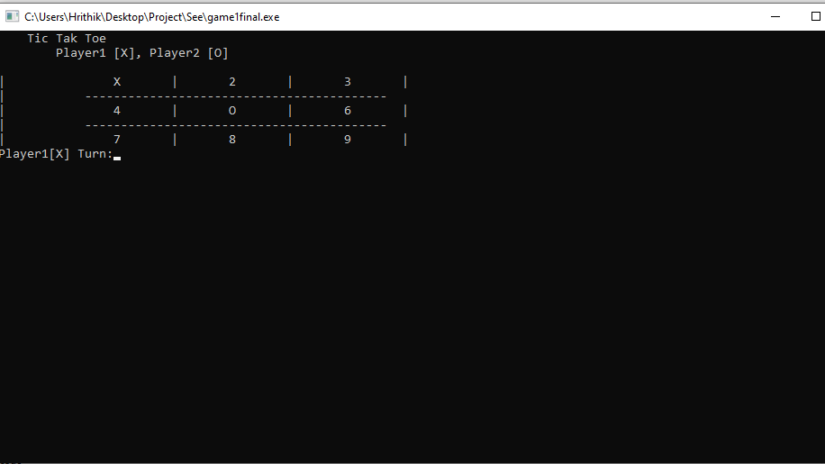
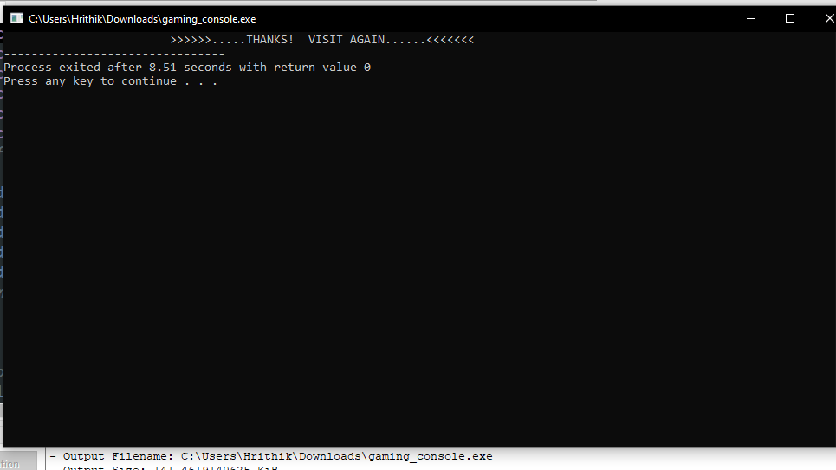
Gameplay

Slide 14

THANK YOU!
Team Gaming Console
From Batch 18,CSE

